Slide 1
Inheritance
Chapter 5

Slide 2
Inheritance:
The capability of a class to derive properties and characteristics from another class is called Inheritance. It is the method by which new classes are created or derived from the existing class. The“:” operator is used for creating the new class. It is the most powerful feature of oops. Inheritance is like inheriting the feature of parents. The derived class inherits all the capabilities of the base class but also can add new capabilities of its own.
Inheritance is also called a kind of relationship. It supports the concept of reusability, which ensure ease of distributing class libraries. Once a class has been written and tested, its feature can be adapted by other programmers whenever required.

Slide 3
In C++, it is possible to inherit attributes and methods from one class to another. We group the "inheritance concept" into two categories:
derived class (child) - the class that inherits from another class
base class (parent) - the class being inherited from

Slide 4
Syntax of inheritance:
class base_class_name
{
…………….
…………….
};
class derived_class_name: access_specifier base_class_name
{
…………….
…………….
};

Slide 5
Simple program of Inheritance
#include<iostream>
using namespace std;
class base
{
protected:
int x;
public:
void getdata()
{
cout<< "Enter value of x in base class\n";
cin>>x;
}
};
class derive: public base
{
private:
int y;
public:
void readdata()
{
cout<< "Enter the value of y in derived class\n";
cin>>y;
}
void sum()
{
cout<< "sum of x and y is"<<x+y;
}
};
main()
{
derive d1;
d1.getdata();
d1.readdata();
d1.sum();
}

Slide 6
Access specifier in inheritance:
Access specifier can be either private or protected or public. In general access specifiers are the access restriction imposed during the derivation of different subclasses from the base class.
private access specifier
protected access specifier
public access specifier

Slide 7
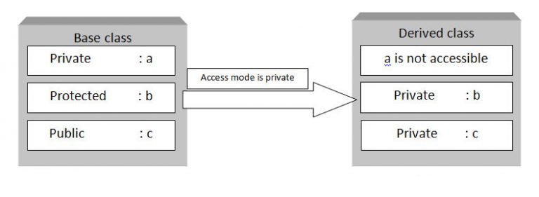
private access specifier
If private access specifier is used while creating a class, then the public and protected data members of the base class become the private member of the derived class and private member of base class remains private.
Following block diagram explain how data members of base class are inherited when derived class access mode is private.

Slide 8
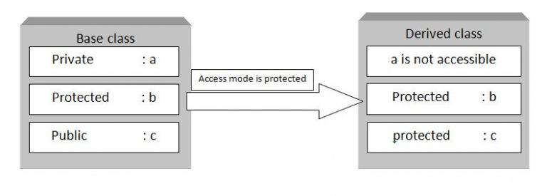
Protected Access Specifier
If protected access specifier is used while deriving class then the public and protected data members of the base class becomes the protected member of the derived class and private member of the base class are inaccessible.
In this case, the members of the base class can be used only within the derived class as protected members except for the private members.
Following block diagram explain how data members of base class are inherited when derived class access mode is protected.

Slide 9
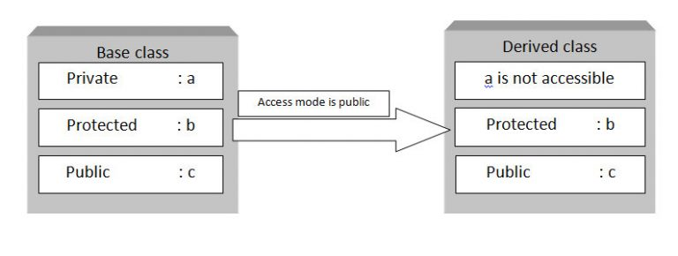
public access specifier
If public access specifier is used while deriving class then the public data members of the base class becomes the public member of the derived class and protected members becomes the protected in the derived class but the private members of the base class are inaccessible.
Following block diagram explain how data members of base class are inherited when derived class access mode is public

Slide 10
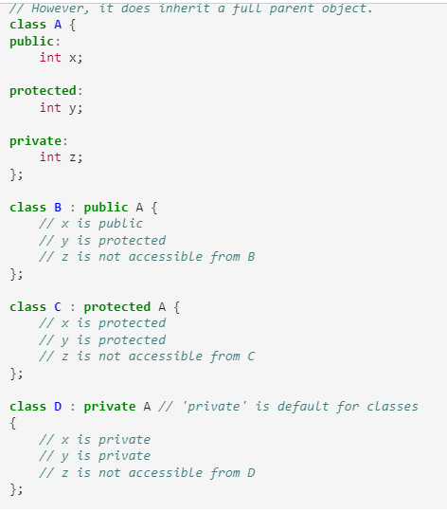

Slide 11
Types of inheritance (level)
The level of inheritance refers to the length of its path from the root (top base class).
Types of inheritance (level) are given below:

Slide 12
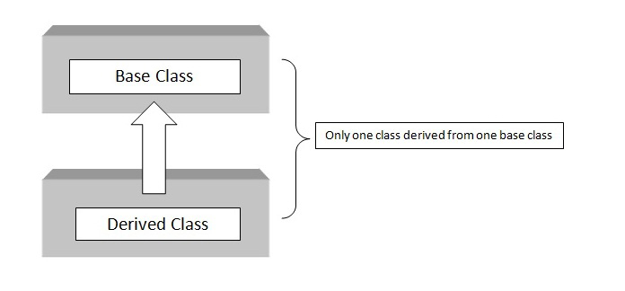
1) Single Inheritance:
When a class is derived from only one base class, it is called single inheritance.

Slide 13
Syntax of single inheritance:
class A
{
……….
……….
};
class B:public A
{
……….
……….
};

Slide 14
// Example of Simple Inheritance
#include<iostream>
using namespace std;
class base
{
protected:
int x;
public:
void getdata()
{
cout<< "Enter value of x in base class\n";
cin>>x;
}
};
class derive: public base
{
private:
int y;
public:
void readdata()
{
cout<< "Enter the value of y in derived class\n";
cin>>y;
}
void sum()
{
cout<< "sum of x and y is"<<x+y;
}
};
main()
{
derive d1;
d1.getdata();
d1.readdata();
d1.sum();
}

Slide 15
2) Multilevel inheritance:
The derivation of class from another derived class is called multilevel inheritance.
A
B
C

Slide 16
Syntax:
class A
{
……….
……….
};
class B: public A
{
……….
……….
};
class c: public B
{
………
………
};

Slide 17
// example of multilevel inheritance
#include <iostream>
using namespace std;
class base //single base class
{
protected:
int x;
public:
void getdata()
{
cout << "Enter value of x= ";
cin >> x;
}
};
class derive1 : public base // derived class from base class
{
protected:
int y;
public:
void readdata()
{
cout << "\nEnter value of y= ";
cin >> y;
}
};
class derive2 : public derive1 // derived from class derive1
{
private:
int z;
public:
void indata()
{
cout << "\nEnter value of z= ";
cin >> z;
}
void product()
{
cout << "\nProduct= " << x * y * z;
}
};
main()
{
derive2 a; //object of derived class
a.getdata();
a.readdata();
a.indata();
a.product();
}

Slide 18
3) Hierarchical inheritance:
When several class are derived from single base class i.e. feature of one class may be inherited by more than one class, then it is called hierarchical inheritance.
A
B
C
D

Slide 19
Syntax:
class A
{
………
………
};
class B: public A
{
………
………
};
class C: public A
{
………
………
};
class D: public A
{
………
………
};

Slide 20
//Example of hierarchial inheritance
#include <iostream>
using namespace std;
class A
{
protected:
int x, y;
void getdata()
{
cout << "\nEnter value of x and y:\n";
cin >> x >> y;
}
};
class B : public A
{
public:
void product()
{
cout << "\nProduct= " << x * y;
}
};
class C : public A
{
public:
void sum()
{
cout << "\nSum= " << x + y;
}
};
main()
{
B obj1;
C obj2;
obj1.getdata();
obj1.product();
obj2.getdata();
obj2.sum();
}

Slide 21
Example of hierarchical inheritance(Class hierarchies):
employee
name
number
Manager
Scientist
Laborer
title
publications
Club dues

Slide 22
Example of hierarchical inheritance
#include<iostream>
using namespace std;
class employee
{
protected:
char name[30];
int number;
public:
void getdata()
{
cout<<"Enter name and number\n";
cin>>name>>number;
}
void putdata()
{
cout<<"Name is"<<name;
cout<<"Number is"<<number;
}
};
class manager: public employee
{
private:
char title[30];
int dues;
public:
void mgetdata()
{
cout<<"Enter title and dues\n";
cin>>title>>dues;
}
void mputdata()
{
cout<<"Title is"<<title;
cout<<"Dues is"<<dues;
}
};

Slide 23
class scientist: public employee
{
private:
char pubs[30];
public:
void sgetdata()
{
cout<<"Enter publication";
cin>>pubs;
}
void sputdata()
{
cout<<"publication is"<<pubs;
}
};
class laborer: public employee
{
};
main()
{
manager m1;
scientist s1;
laborer l1;
cout<<"Enter data for manager\n";
m1.getdata();
m1.mgetdata();
cout<<"Enter data for scientist\n";
s1.getdata();
s1.sgetdata();
cout<<"Enter data for laborer\n";
l1.getdata();
cout<<"Data of manager\n";
m1.putdata();
m1.mputdata();
cout<<"Data of scientist\n";
s1.putdata();
s1.sputdata();
cout<<"Data of laborer\n";
l1.putdata();
}

Slide 24
4) Multiple Inheritance:
A class may be able to inherit from two or more classes, such an inheritance is called multiple inheritance.
A
B
C

Slide 25
Syntax:
class A
{
………
………
};
class B
{
………
………
};
class C:public A,public B
{
………
………
};

Slide 26
// Example of multiple inheritance.cpp
#include<iostream>
using namespace std;
class A
{
protected:
int x;
public:
void getx()
{
cout << "enter value of x: ";
cin >> x;
}
};
class B
{
protected:
int y;
public:
void gety()
{
cout << "enter value of y: ";
cin >> y;
}
};
class C : public A, public B
{
public:
void sum()
{
cout << "Sum = " << x + y;
}
};
main()
{
C obj1;
obj1.getx();
obj1.gety();
obj1.sum();
}

Slide 27
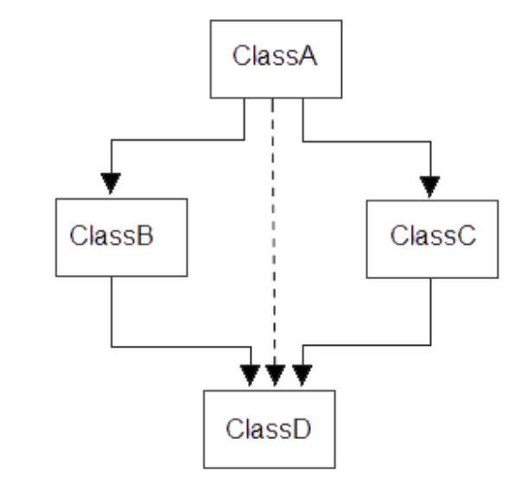
Multipath Inheritance
Multipath Inheritance in C++ is derivation of a class from other derived classes, which are derived from the same base class.
Here class D is derived from class B and C.
Class B and C are child of class A.
From the above two points,we can say class D is indirectly derived from class A.

Slide 28
Limitations of multipath inheritance
If virtual keyword is not used then the grandchild class will get two copies of data members from parent class.
This type of inheritance is very ambiguous.

Slide 29
6) Hybrid inheritance
Derivation of class involving more than one form of any inheritance is called hybrid inheritance.
A
B
C
D

Slide 30
Syntax of hybrid inheritance:
class A
{
……
……
};
class B:public A
{
……
……
};
class C
{
……
……
};
class D:public B, public C
{
……
……
};

Slide 31
//Example of hybrid inheritance
#include <iostream>
using namespace std;
class A
{
protected:
int x;
};
class B : public A
{
public:
B()
{
x = 10;
}
};
class C
{
protected:
int y;
C()
{
y = 4;
}
};
class D : public B, public C
{
public:
void sum()
{
cout << "Sum= " << x + y;
}
};
main()
{
D obj1;
obj1.sum();
}

Slide 32
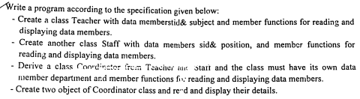
#include<iostream>
using namespace std;
class Teacher
{
protected:
int tid;
char subject[50];
public:
void treaddata()
{
cout<<"Enter tid and subject"<<endl;
cin>>tid>>subject;
}
void tdisplaydata()
{
cout<<"your tid is:"<<tid<<endl;
cout<<"your subject is:"<<subject<<endl;
}
};

Slide 33
class Staff
{
protected:
int sid;
char position[50];
public:
void sreaddata()
{
cout<<"Enter sid and position"<<endl;
cin>>sid>>position;
}
void sdisplaydata()
{
cout<<"your sid is:"<<sid<<endl;
cout<<"your position is:"<<position<<endl;
}
};

Slide 34
class Coordinator :public Teacher, public Staff
{
private:
char department[50];
public:
void creaddata()
{
cout<<"Enter coordinator department"<<endl;
cin>>department;
}
void cdisplaydata()
{
cout<<"your department is:"<<department<<endl;
}
};

Slide 35
main()
{
Coordinator c1,c2;
c1.treaddata();
c1.tdisplaydata();
c1.sreaddata();
c1.sdisplaydata();
c1.creaddata();
c1.cdisplaydata();
c2.treaddata();
c2.tdisplaydata();
c2.sreaddata();
c2.sdisplaydata();
c2.creaddata();
c2.cdisplaydata();
}

Slide 36
Ambiguity in Inheritance
Generally while using the inheritance feature we face the problem in case of multiple, multipath and hybrid form of inheritance i.e. when we use the above mentioned form of inheritance having same function name in all the base classes and try to access it through the object of derived class then compiler shows error. Such error occurrence in inheritance is called ambiguity.

Slide 37
Example 1) Ambiguity in multiple inheritance
class B
{
public:
void display()
{
cout<< "from class B";
}
};
class c:public A, public B
{
};
main()
{
c c1;
c1.display(); //ambiguous(will not compile)
}
#include<iostream>
using namespace std;
class A
{
public:
void display()
{
cout<<"from class A";
}
};

Slide 38
Solution:
a) The problem is resolved using scope resolution operator to specify the class in which the function lies.
main()
{
c c1;
c1.A::display(); //compile
c1.B::display(); //compile
}
b) Another way to solve the problem is by the concept of virtual base class.

Slide 39
2. Ambiguity in multipath inheritance
Another kind of ambiguity arises if we derive a class from two classes that are each derived from the same class which is called multipath inheritance. In this case, public or protected member of grandparent is derived in the child class twice which creates confusion to the compiler.
We can remove this kind of ambiguity by using the concept of virtual base class .

Slide 41
In the above example, both ClassB & ClassC inherit ClassA, they both have single copy of ClassA. However ClassD inherit both ClassB & ClassC, therefore ClassD have two copies of ClassA, one from ClassB and another from ClassC.
Compiler can't differentiate between two copies of ClassA in ClassD. So error occurs in the program. So to remove error we have to use virtual base class concept.
Virtual base class is used when multiple and multipath inheritance occurs.

Slide 42
Example of multipath inheritance
#include <iostream>
using namespace std;
class person
{
protected:
char name[100];
int code;
public:
void input()
{
cout<<"\nEnter the name of the person : ";
cin>>name;
cout<<endl<<"Enter the code of the person : ";
cin>>code;
}
void display()
{
cout<<endl<<"Name of the person : "<<name;
cout<<endl<<"Code of the person : "<<code;
}
};

Slide 43
class account:virtual public person
{
protected:
float pay;
public:
void getpay()
{
cout<<endl<<"Enter the pay : ";
cin>>pay;
}
void display()
{
cout<<endl<<"Pay : "<<pay;
}
};

Slide 44
class admin: virtual public person
{
protected:
int experience;
public:
void getexp()
{
cout<<endl<<"Enter the experience : ";
cin>>experience;
}
void display()
{
cout<<endl<<"Experience : "<<experience;
}
};
class master:public account,public admin
{
private:
char n[100];
public:
void gettotal()
{
cout<<endl<<"Enter the company name : ";
cin>>n;
}
void display()
{
cout<<endl<<"Company name : "<<n;
}
};
main()
{
master m1;
m1.input();
m1.getpay();
m1.getexp();
m1.gettotal();
m1.person::display();
m1.account::display();
m1.admin::display();
m1.display();
}

Slide 45
Constructors and Destructors in Inheritance
In C++ inheritance, the constructors and destructors are not inherited by the derived class, but we can call the constructor of the base class in derived class.
The constructors will be called by the complier in the order in which they are inherited. It means that base class constructors will be called first, then derived class constructors will be called.
The destructors will be called in reverse order in which the compiler is declared.
We can also call the constructors and destructors manually in the derived class.

Slide 46
Constructor in derived class:
If we want to initialize a derived class object to a value then we have to write a new set of constructor for the derived class. When both the derived and base class contain constructor, the base class constructor is executed first and then the derived class constructor is executed.

Slide 47
Example of Constructor in derived class:
#include<iostream>
using namespace std;
class base
{
protected:
int count;
public:
base()
{
count =0;
}
base(int i)
{
count =i;
}
void display()
{
cout<<"count is "<<count<<"\n";
}
void increment()
{
count++;
}
};
class derive : public base
{
public:
derive():base()
{
}
derive(int i): base(i)
{
}
void decrement()
{
count--;
}
};
main()
{
derive i1;
derive i2(200);
i1.display();
i2.display();
i1.increment();
i1.increment();
i1.display();
i2.decrement();
i2.display();
}
Output:
count is 0
count is 200
count is 2
count is 199

Slide 48
Abstract class:
To exploit the potential benefit of inheritance, the base classes are improved or enhanced without modifications. The objects created are often the instances of a derived class but not of the base class. The base class becomes just the foundation for the building new classes and hence such classes are called abstract class.
It is one that has no instance and is not designed to create object. It specifies an interface at a certain level of inheritance and provides a framework, upon which other classes can be build.

Slide 49
Syntax of abstract class:
A class is made abstract by declaring at least one of its functions as pure virtual function. A pure virtual function is specified by placing "= 0" in its declaration as follows :
class Box
{
public:
// pure virtual function
virtual double getVolume() = 0;
private:
double length;
double breadth;
double height;
};

Slide 50
Example of Abstract Class:
class Triangle: public Shape {
public:
int getArea() {
return (width * height)/2;
}
};
main()
{
Rectangle Rect;
Triangle Tri;
Rect.setWidth(5);
Rect.setHeight(7);
// Print the area of the object.
cout << "Total Rectangle area: " << Rect.getArea() << endl;
Tri.setWidth(5);
Tri.setHeight(7);
// Print the area of the object.
cout << "Total Triangle area: " << Tri.getArea() << endl;
}
Output:
Total Rectangle area: 35
Total Triangle area: 17
#include <iostream>
using namespace std;
// Base class
class Shape {
protected:
int width;
int height;
public:
// pure virtual function providing interface framework.
virtual int getArea() = 0;
void setWidth(int w) {
width = w;
}
void setHeight(int h) {
height = h;
}
};
// Derived classes
class Rectangle: public Shape {
public:
int getArea() {
return (width * height);
}
};

Slide 51
Function Overriding:
When the same function exist in both base class and derived class, the function in the derived class will be executed i.e. function in the base class will be overridden by the function in the derived class. Objects of the base class don't know anything about derived class and always use the base class function. If we create an object of derived class and write code to access the same member function then the member function in derived class is only executed. This feature in C++ is called function overriding.

Slide 52
Example of function overriding
#include<iostream>
using namespace std;
class A
{
public:
void getdata()
{
cout<<"In class A";
}
};
class B:public A
{
public:
void getdata()
{
cout<<"In class B";
}
};
main()
{
B b1;
b1.getdata();
}
Output:
In class B

Slide 53
Aggregation /Containership (class with in class)
When a class contains object of another class as its member, it is known as containership. The class which contains the object is called container class. Containership is also called as class within class. It is also called has-a-relationship. Containership is useful with classes that act like a data type. The object of this classes can be used almost like other variables in the class.
In inheritance if a class B is derived from class A then B is a kind of A. This is because B has all the characteristics of A and in addition some of its own. So inheritance if often called a kind of relationship.

Slide 54
Syntax:
Class A
{
………
………
};
Class B
{
A A1; //Here class B contains object of class So B is the container class
};

Slide 55
Example of Containership:
class employee
{
char department[20];
manager m;
public:
void getdata()
{
m.getdata();
cout<<"enter department:"<<endl;
cin>>department;
}
void putdata()
{
m.putdata();
cout<<"your department is "<<department;
}
};
main()
{
employee e;
e.getdata();
e.putdata();
}
#include<iostream>
using namespace std;
class manager
{
char name[20];
int age;
public:
void getdata()
{
cout<<"enter name and age"<<endl;
cin>>name>>age;
}
void putdata()
{
cout<<"your name is"<<name<<endl;
cout<<"your age is "<<age<<endl;
}
};

Slide 56
Difference between function overloading and function overriding:
function overloading
function overriding
It may occur without inheritance.
It takes place at compile time.
It is the form of static polymorphism.
It requires at least one class to occur.
It always require the inheritance to occur.
It takes place at runtime.
It is the form of dynamic polymorphism.
It requires at least two classes to occur( i.e. base class & derived class.

Slide 57
function overloading
function overriding
5) It takes place in between the function which are in the same scope or different scope.
6) A function will be called directly without the help of scope resolution operator(::)
5) It takes place in between the function which are in the different scope only.
6) The derived class function overrides the base class function.

Slide 58
Example of function overloading.
#include<iostream>
using namespace std;
class rectangle
{
private:
int l,b;
public:
void getdata()
{
cout<<"Enter length and breadth\n";
cin>>l>>b;
}
void getdata(int l1, int b1)
{
l=l1;
b=b1;
}
void getdata(double l1, double b1)
{
l=l1;
b=b1;
}
void displaydata()
{
int a;
a= l*b;
cout<<"Area is"<<a;
}
};
main()
{
rectangle r1;
r1.getdata();
rectangle r2;
r2.getdata(4,5);
rectangle r3;
r3.getdata(5.8,7.6);
r1.displaydata();
r2.displaydata();
r3.displaydata();
}

Slide 59
Example of function overriding
#include<iostream>
using namespace std;
class A
{
public:
void getdata()
{
cout<<"In class A";
}
};
class B:public A
{
public:
void getdata()
{
cout<<"In class B";
}
};
main()
{
B b1;
b1.getdata();
}
Output:
In class B

Slide 60
Friend function:
We know that private member can’t be accessed from outside the class, i.e. non member function can’t access private member of a class but by using friend function, we can access private members of class. Friend function can be executed like a normal function without the help of object.
Friend function usually has objects as arguments to make function friendly to a class, we have to simply declare this function as a friend of class.

Slide 61
Example of friend function:
#include<iostream>
using namespace std;
class sample
{
private:
int a,b;
public:
void setvalue()
{
a=25;
b=40;
}
friend float mean(sample s);
};
float mean (sample s)
{
return(s.a+s.b)/2.0;
}
main()
{
sample x;
x.setvalue();
cout<<"mean value is"<<mean(x);
}
Output:
mean value is 32.5

Slide 62
Friend class:
A friend class in c++ can access the private and protected member of class in which it is declared as friend. We can also declare all member of one class as friend of another class. Such a class is called friend class. In friend class the second class can access to the protected and private members of the first class.

Slide 63
Syntax of friend class:
class x
{
private:
…….
…….
};
class y
{
…….
friend class x; // All member of x are friend to y
};

